Slide 1


IBF-MS-Daily Health Check Report -2019/07/19 – 05:30
IBF-MS-Daily Health
Check Report:
06/10/2019 15:25
IBF MANAGED SERVICES
REPORTING
INNOVATING SINCE 2002

Slide 2
Standard Daily Feedback
Part 1

Slide 3
IBF Health Check Summary
Component | Health Check Item | Comments
OA&M Dashboard | Application Server Queue Build-up | No queue build up
 | Status of Re-provision Job | OK 100% Complete
 | Health of T2 Adapters in terms of response times and failure rates | OK
 | Health of business processes in terms of response times and failure rates | OK
 | Health of T1 Adapters in terms of response times and failure rates | OK
Launch Log | Status of Launch Log | OK
Zabbix Triggers (OS Monitoring and Network Monitoring) | Number of triggers received | OK
Functional Tests | Disconnect, Provision, Recharge, Bundle Purchase etc. | OK
Blade Monitoring | Status of Blade Enclosures | OK
Pre-Production | Availability of Pre-Prod Environment | OK

Slide 4
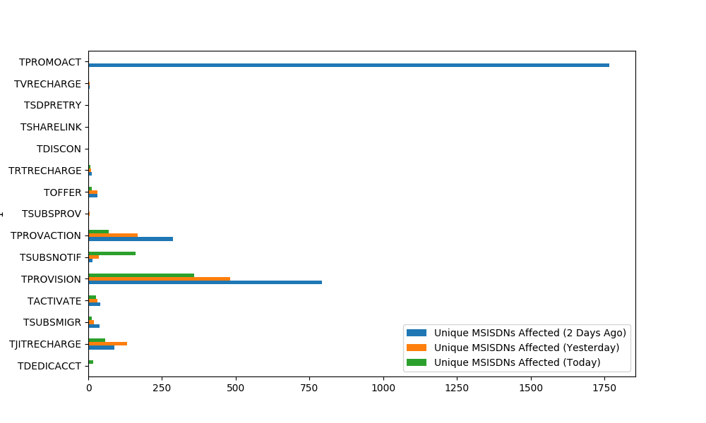
Business Process Exception Trends For the past 3 days

Slide 5
Business Process Exception Trends continued …
Severity | Service Name | 2 Days Ago | 1 Day Ago | Today | Total Invocations 2 Days Ago | Total Invocations 1 Days Ago | Total Invocations Today | Retry % 2 Days Ago | Retry % 1 Day Ago | Retry % Today | Comments
RETRY | TDEDICACCT | 0 | 0 | 16 | 0 | 0 | 2289009 | 0 | 0 | .0007 | None
RETRY | TJITRECHARGE | 88 | 131 | 57 | 9141633 | 8802015 | 3635500 | .00096 | .00149 | .00157 | None
RETRY | TSUBSMIGR | 38 | 19 | 11 | 2387 | 897 | 407 | 1.59196 | 2.11817 | 2.7027 | None
RETRY | TACTIVATE | 41 | 31 | 27 | 127023 | 108451 | 40035 | .03228 | .02858 | .06744 | None
RETRY | TPROVISION | 793 | 480 | 360 | 7276113 | 6915714 | 5226717 | .0109 | .00694 | .00689 | None
RETRY | TSUBSNOTIF | 15 | 35 | 161 | 25199011 | 24357087 | 11220367 | .00006 | .00014 | .00143 | None
RETRY | TPROVACTION | 288 | 167 | 69 | 10818944 | 10239403 | 6719741 | .00266 | .00163 | .00103 | None
RETRY | TSUBSPROV | 2 | 5 | 1 | 176737 | 148343 | 52673 | .00113 | .00337 | .0019 | None
RETRY | TOFFER | 32 | 32 | 13 | 4430972 | 4144186 | 2096648 | .00072 | .00077 | .00062 | None
RETRY | TRTRECHARGE | 11 | 10 | 6 | 9135999 | 8797970 | 3633945 | .00012 | .00011 | .00017 | None
RETRY | TDISCON | 0 | 3 | 0 | 0 | 116874 | 0 | 0 | .00257 | 0 | None
RETRY | TSHARELINK | 1 | 0 | 0 | 44256 | 0 | 0 | .00226 | 0 | 0 | None
RETRY | TSDPRETRY | 1 | 0 | 0 | 7306 | 0 | 0 | .01369 | 0 | 0 | None
RETRY | TVRECHARGE | 5 | 4 | 0 | 6612015 | 6314533 | 0 | .00008 | .00006 | 0 | None
RETRY | TPROMOACT | 1766 | 0 | 0 | 8624295 | 0 | 0 | .02048 | 0 | 0 | None

Slide 6
Business Process Exception Detail Period:2019/07/18 17:15 - 2019/07/19 05:55
Service Name | Failed Component Service | Error | Failure Count | Affected Subscribers | Comments
TPROMOACT | TPROVISION | Provision of promotion service option failed. | 23 | 23 | None
TOFFER | TOFFER | FATAL ERROR: DB Logged BP_EXCEPTION before removed from Launch Log | 22 | 16 | None
TDEDICACCT | ACCTSHARE | Dedicated account to share not found in ppasbalancersp | 7 | 6 | None
TVBPROVISION | TPROVISION | Provision failure without pending actions | 5 | 2 | None
TDEDICACCT | PPADJUST | Failed to call Debit PPADJUST | 3 | 3 | None

Slide 7
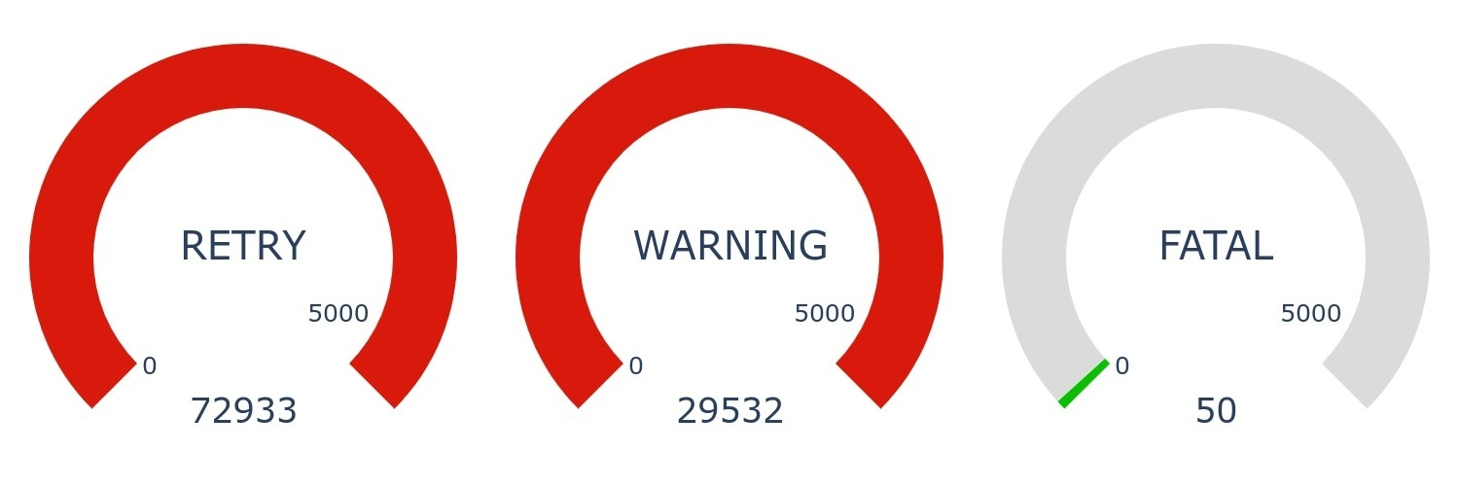
Business Process Exception Detail Customers potentially affected by warnings, retry and fatal errors
RETRY
• These are based on the following exception/error:
500: Retry TPROVISION: PPBalance failed (4977): 500
Error 500: To be populated
WARNING
• These are based on the following exception/error:
756: SPROVISION failed (BP error) : 756
Error 756: To be populated
Retries is based on over all retries this will include migration retries, provisioning retries etc.
Warnings aren’t something to be concerned with, its there to see when something went wrong with business logic and aren’t based on things that need to be fixed.
Fatal are retries that failed and resulted in fatal errors and need to be investigated.

Slide 8
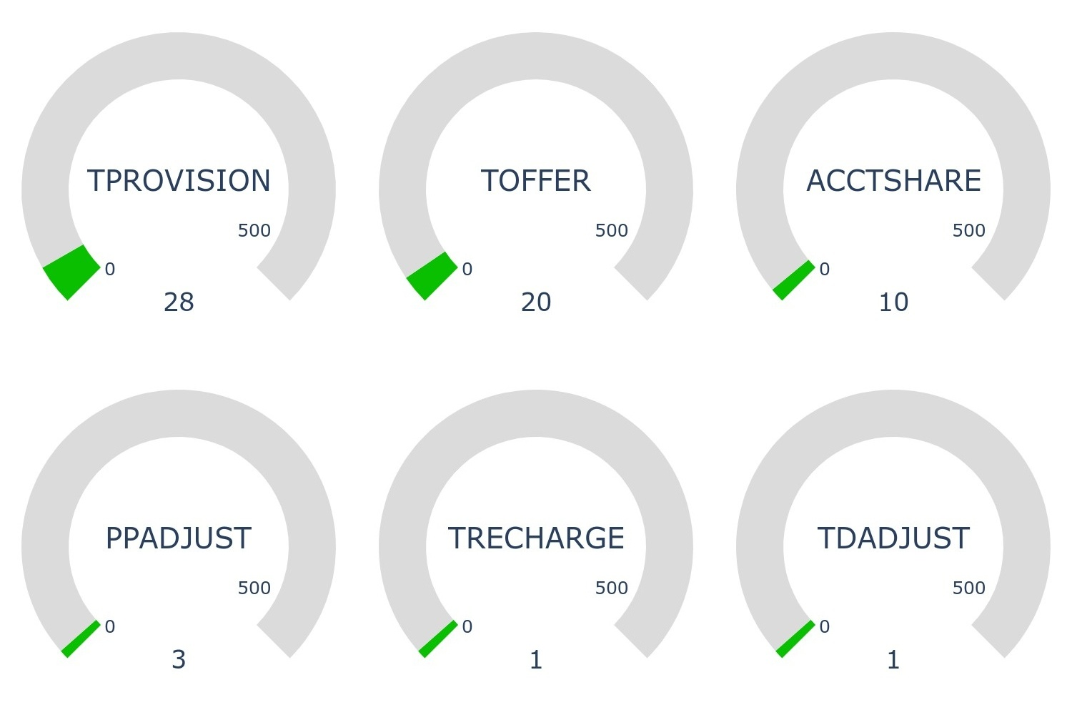
Business Process Exceptions Fatal failures measured by number of subscribers affected
Top 12 services resulting in failures
Top 2 error RCA and Actions
TOFFER
We are presently experiencing fatal errors on service TOFFER.
This is caused by (RCA):
To be investigated.
The present actions to resolve this is as follows:
To be investigated.
TRECHARGE
We are presently experiencing fatal errors on service TRECHARGE
This is caused by (RCA):
To be investigated.
The present actions to resolve this is as follows:
To be investigated.
.

Slide 9
The End
IBF Managed Services Daily Report

